Slide 1

LAW-TRAIN –
Virtual Investigative
Interview Training Platform
LAW-TRAIN has received funding from the European Union‘s Horizon 2020 research and innovation programme under grant agreement No. 653587
H2020 – EU funded Project

Slide 2
Table of Content
About LAW-TRAIN
  What, Why & Who?
Partners
Objectives
Contact

Slide 3
About LAW-TRAIN
1
What, Why & Who?

Slide 4
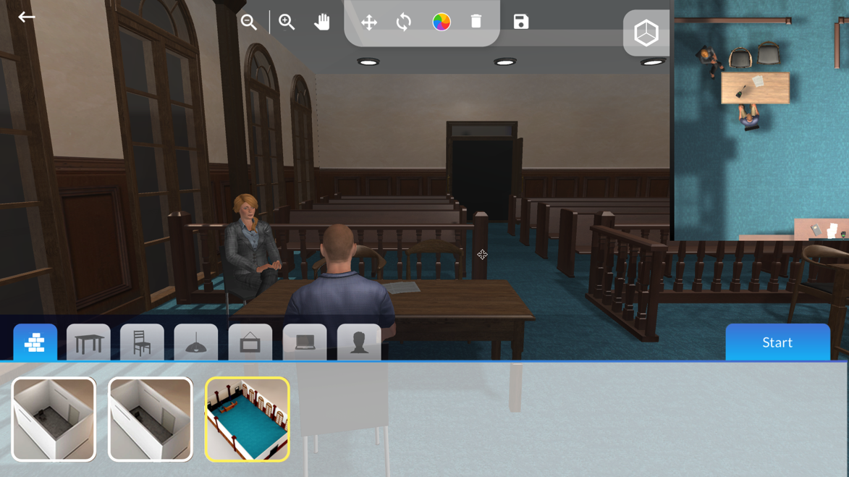
About LAW-TRAIN
1
LAW-TRAIN is an European Commission funded project aimed at fighting international drug trafficking by developing a virtual investigative interview training platform. The training system is developed in a collaborative action by universities, national governments and professional enterprises.

Slide 5
About LAW-TRAIN
1
What?
  LAW-TRAIN is a multinational project, to establish a training system for educating law enforcement personnel in international drug trafficking by forming a joint investigation team. This project specifically provides a cross-border training service. It has been conducted within a virtual environment which contains virtual as well as real characters. In order to meet the objectives of LAW-TRAIN, technical, as well as methodological and end user partners from various countries have been responsible for creating a new and innovative way for training law enforcement personnel in drug trafficking.

Slide 6
About LAW-TRAIN
1
Why?
  Crime, such as drug trafficking, is a multi-national issue which often leads to cross-border investigations, and these are beset by obstacles and miscommunication due to different cultural, legal and training aspects. With LAW-TRAIN, law enforcement agencies can cut costs while effectively training their personnel in the conduct of joint investigative interviewing through a virtual training platform.

Slide 7
About LAW-TRAIN
1
Who?
  LAW-TRAIN is a Horizon 2020 project funded by the European Commission.
  Bar-Ilan University is the initiator and the coordinator of the project, with the Consortium comprising ten partners from six countries.

Slide 8
About LAW-TRAIN
1
Key Benefits
  Cost effective, multinational and highly realistic virtual training platform
  Newest technologies of virtual and augmented reality
  Competencies in investigative interviewing (PEACE methodology)
  Ad hoc virtual team coordination skills
  Transnational collaboration and collaborative decision making skills
  Parallel training opportunities anytime and anywhere in multiple locations
  New characters and realistic training scenarios can be created easily, similar to real life multinational investigations

Slide 9
About LAW-TRAIN
1
Key Innovations
  Mixed Reality (VR and AR) and Artificial Intelligence Simulator of an investigation environment
  Virtual Suspect that can be interviewed by trainees from various countries
  Virtual Trainer that can provide automated, standardized feedback to trainees
  Human Trainer who will observe the training and provide real time feedback to the trainees

Slide 10
Ethical Issues
1
LAW-TRAIN has recently passed the Ethics Check by H2020 with the result “Good to excellent compliance with the H2020 ethical guidelines” concerning all requested items!
For further information please visit the LAW-TRAIN Website
  Ethical Guidelines: http://www.law-train.eu/ethical-guidelines/
  FAQs: http://www.law-train.eu/faq/

Slide 11
Partners
2
The Consortium

Slide 12
Partners
2

Slide 13
Partners
2
Bar-Ilan University, Israel (Coordinator)
Compedia, Israel
KU Leuven, Belgium
Optimización orientada a la sostenibilidad S.L., Spain
USECON – The Usability Consultants, Austria
Le Service Public Federal Justice, Belgium
Guardia Civil, Spain (End User)
Ministry of Public Security / Israel National Police , Israel (End User)
Instituto de Engenharia de Sistemas
e Computadores, Investigação e Desenvolvimento em Lisboa, Portugal (End User)
Inspectoratul General al Politiei Romane, Romania (End User)

Slide 14
Objectives
3

Slide 15
Objectives
3
LAW-TRAIN aimed to develop
  a collaborative international virtual investigative interviewing platform for training law enforcement units in the field of drug trafficking
  a virtual suspect that can be interviewed by trainees from various countries
  a virtual trainer that can provide automated, standardised feedback to trainees
  a human trainer who will observe the training and provide real time feedback to the trainees
  training tools for the trainer that generate new characters and scenarios easily
  a virtual environment in which the joint investigation team can interview the virtual
  suspect (VS) and communicate with each other

Slide 16

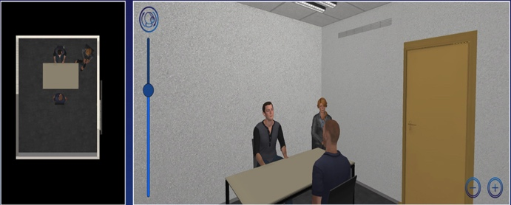
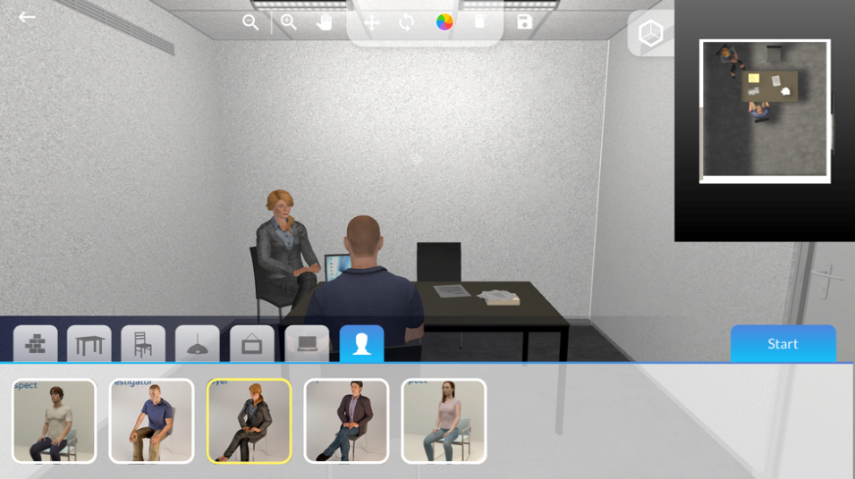
Example Screens
3

Slide 17
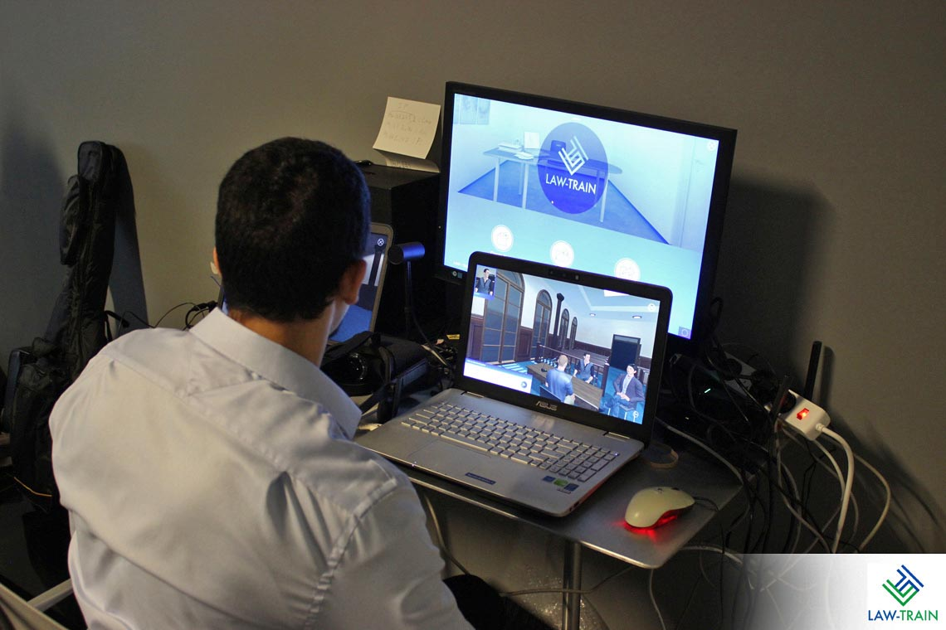
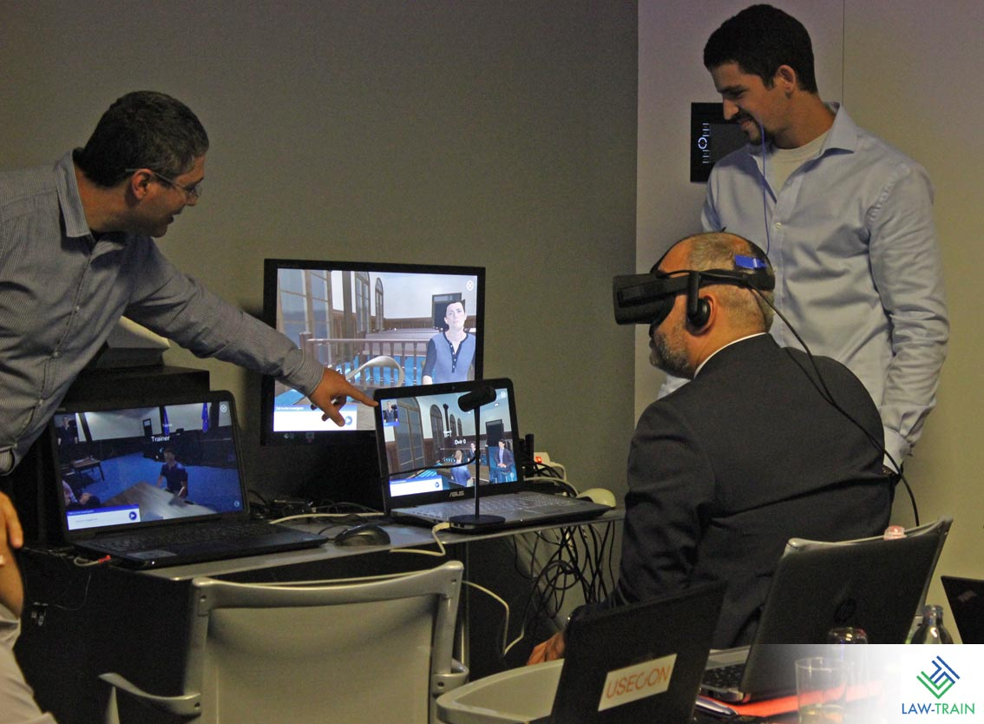
Example Screens
3
Notes:
Neue Visuals einfügen, siehe Poster

Slide 18
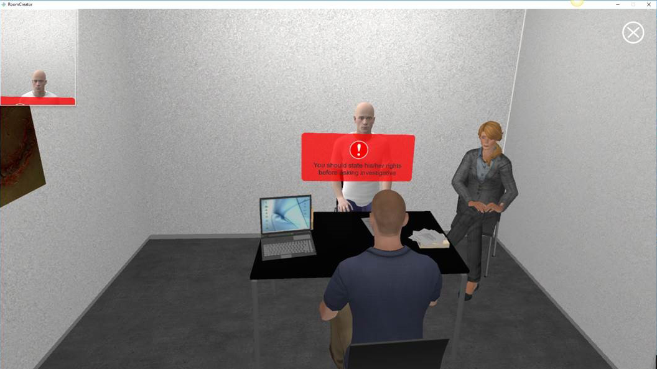
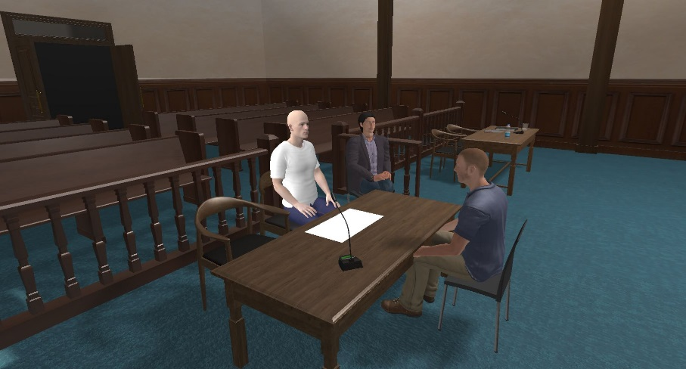
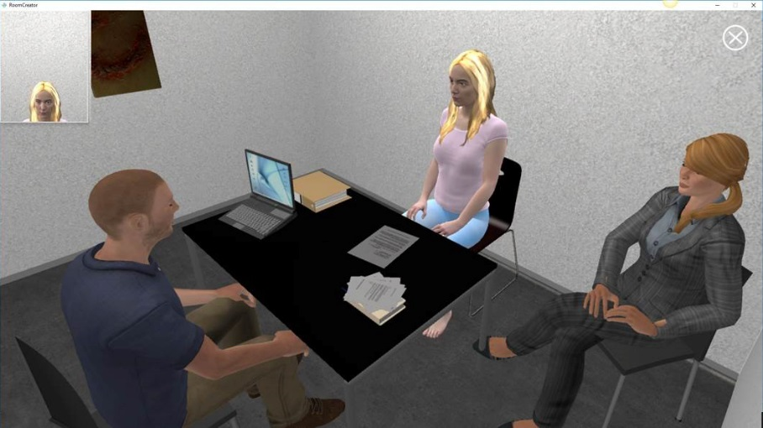
Example Screens
3
Notes:
Neue Visuals einfügen, siehe Poster

Slide 19
Contact
4
Contact & Project Details

Slide 20
Contact & Project Details
4
www.law-train.eu
Prof. Sarit Kraus
European R&D Unit Bar-Ilan University
sarit@umiacs.umd.edu
+972-3-738-4275
Project number: 653587
Project Acronym: LAW-TRAIN
Duration: 1/5/2015 – 30/4/2918
Instrument: RIA
Call: H2020-FTC-2014
LAW-TRAIN has received funding from the European Union’s Horizon 2020 research and innovation programme under grant agreement No 653587.

